Slide 1


Hotel Booking Analysis by Python Assignment given by Prepared by Jane Alam Bengaluru

Slide 2
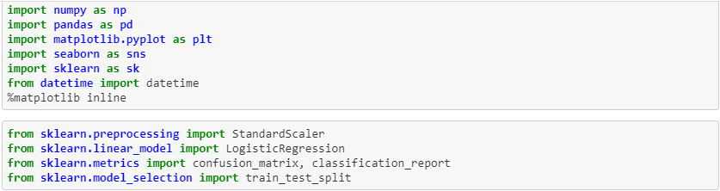
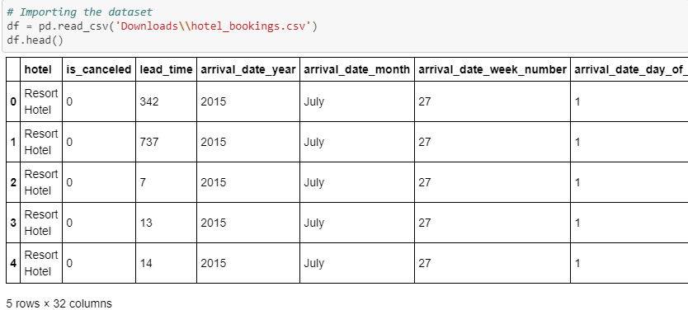
Importing Python Libraries & Data

Slide 3
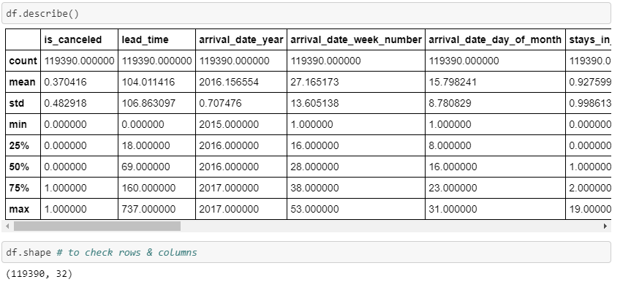
EDA of dataset

Slide 4
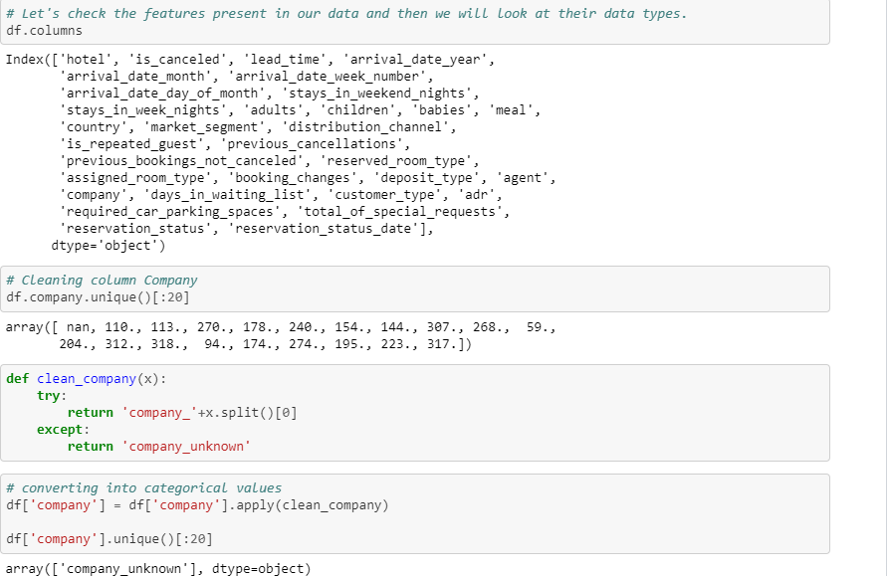
Cleaning Data

Slide 5
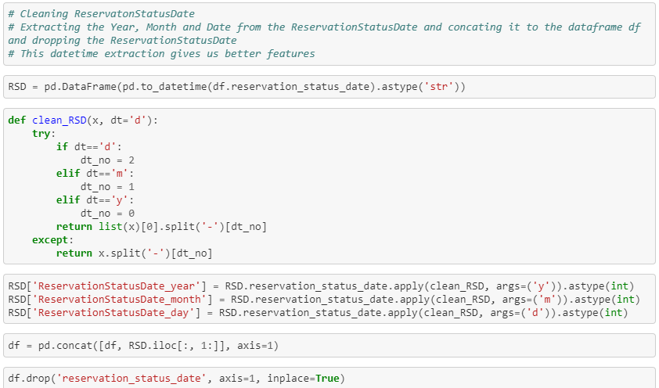
Cleaning Reservation data

Slide 6
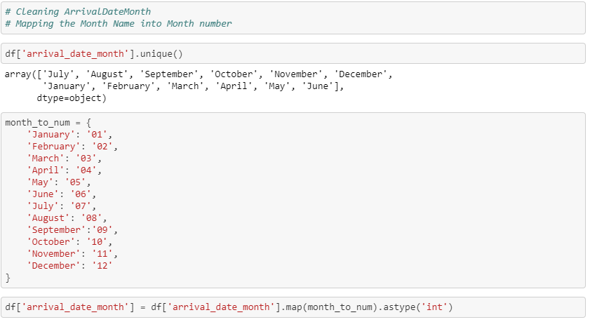
Cleaning Arrival date month and mapping

Slide 7
This way I cleaned the following data information like Meal, Reservation_Status, Country, Customer_Type, Distribution_Channel, Market_Segment and so on.

Slide 8
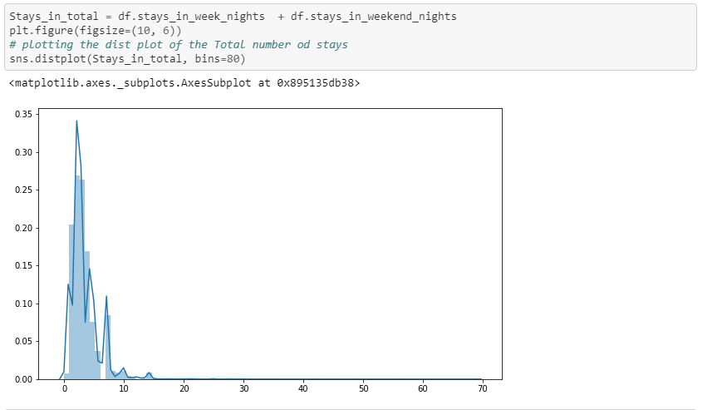
Distribution plot, Stay in week nights vs Stay in weekend nights

Slide 9
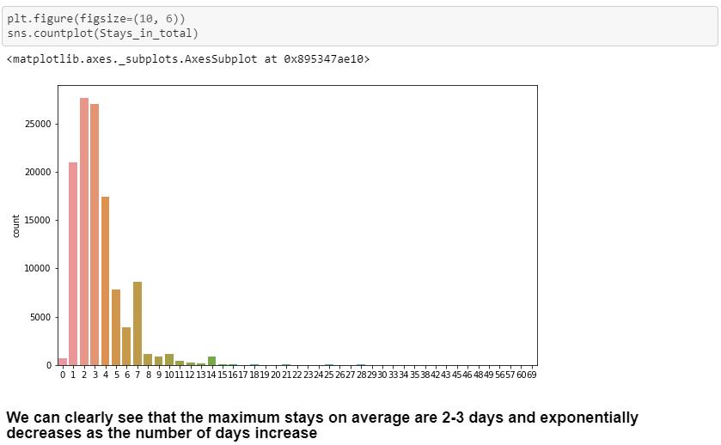
Histogram, Stay in total

Slide 10
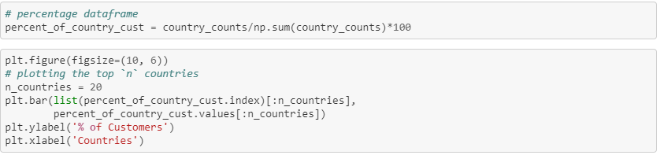
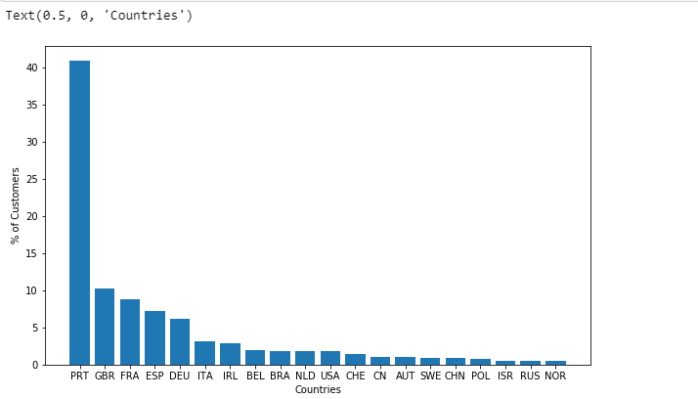
Counting and plotting countries with highest number of customers. Portugal has highest number of customers

Slide 11
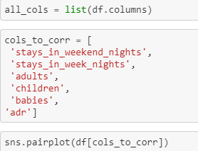
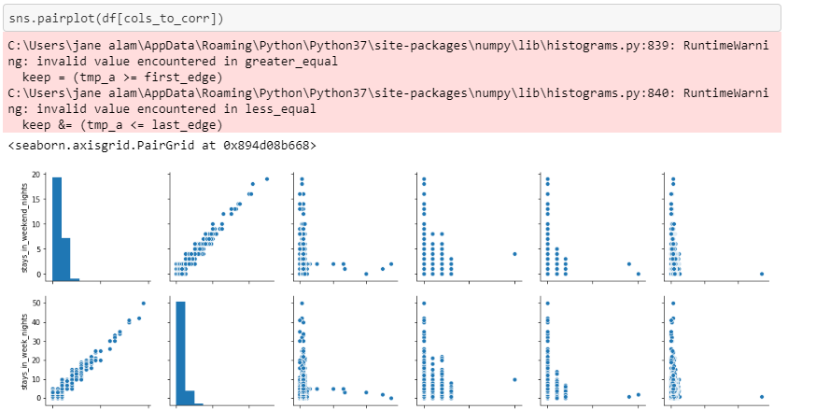
Using a correlation matrix to visualize the relationships between various features in the dataset. StaysinWeekNights & StaysinWeekendNights are highly correlated

Slide 12
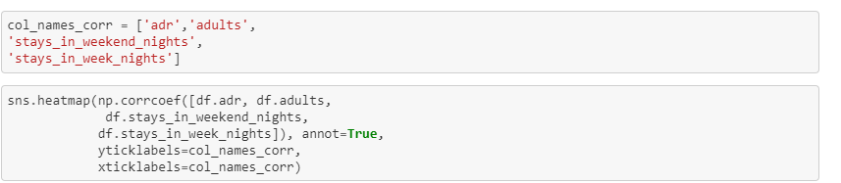
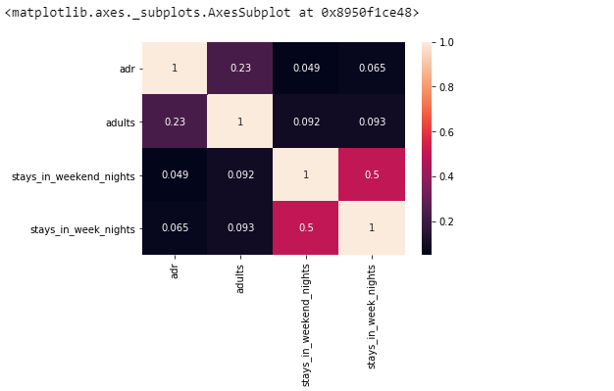
Heatmap for to visualize the relationships between various features in the dataset.

Slide 13
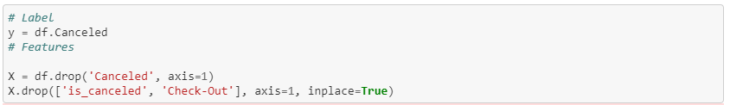
Now Data is going under Training & Testing

Slide 14

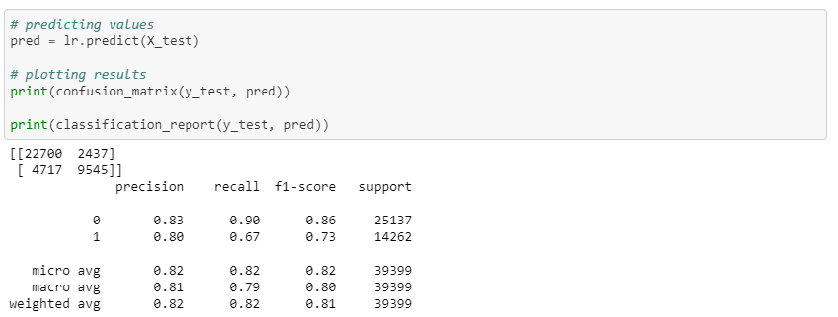
Using Logistic Regression Algorithm to predict the data

Slide 15
Conclusion: Logistic Regression is a statistical technique of binary classification. In this data, I have trained the machine to use logistic regression. Once I have data, my next major task was cleansing the data, eliminating the unwanted rows, fields, and select the appropriate fields for our model development. To train the data, I have used about 70% of the data for training the model the rest of the data for testing. I got predicted value around 81% accuracy which is good for this Hotel Booking data. I am sharing my Github link for more information https://github.com/alamjane/Project/blob/master/Hotel%20Booking.ipynb

Slide 16
Thank You

